Slide 1
IMPLEMENT MORPHOLOGICAL EDGE DETECTION PROCEDURES
Presented by - Ankit Yadav(22123003)

Slide 2
Introduction :
Edge detection is defined as the process of identifying sharp changes in pixel intensity and it is important in various fields like image segmentation, feature recognition and extraction, computer-guided surgery, and motion estimation.
Edges represent abrupt changes in pixel intensities that indicate object boundaries or the boundaries between objects and their background
Edge detection technique is successfully used in reducing the amount of data to be processed.
Edge detection is a very important field in digital image processing and research is ongoing for new techniques.

Slide 3
Edge detection techniques divided into three categories:
gradient-based methods, Laplacian-based methods, and model-based methods
Gradient-Based Methods: This method detects edges by searching for maximums and minimums in the first derivative of the image. Examples of gradient-based are Sobel, Prewitt, and Robert
Laplacian-Based Methods: This method searches for zero-crossings in the second-order derivative expression computed from the image to find edges. Laplacian operator is the most common operator used with zero-crossing method.
Model-Based Methods: This method uses different models or algorithm to locate edges from images some are very application dependent such as using wavelets, fuzzy, SVM , Cellular Automata, and edge detection methods.

Slide 4
Morphological edge detection :
Morphological edge detection is a technique used to extract the edges of objects in an image by applying morphological operations. Morphological operations are mathematical operations that are performed on an image to extract or enhance specific features of interest.
Morphological edge detection is a type of non-gradient based method for extracting edges from images. It is based on the use of morphological operations, such as dilation, erosion, and gradient, to obtain the boundaries of objects in the image. These boundaries are then thresholded to obtain the edges.
Morphological edge detection is to take the morphological gradient of an image, which is defined as the difference between the dilation and erosion of the image using a structuring element. The dilation operation expands the boundaries of the object in the image, while the erosion operation shrinks them. Therefore, taking the difference between the dilation and erosion operations highlights the edges of the objects in the image.

Slide 5
Cont.
Dilation and erosion are two fundamental operations in morphological image processing.
Dilation : Dilation is a morphological operation that is used to expand or grow binary objects in an image. It works by applying a structuring element to each pixel in the binary image and setting the output pixel to 1 if any of the pixels in the structuring element is 1. This has the effect of making the binary objects larger and more connected. It is used to fill in gaps between objects, connect disjoint objects, and smooth out the edges of objects. It can also be used to remove small holes or gaps within objects.
Erosion : Erosion is a morphological operation that is used to shrink or erode binary objects in an image. It works by applying a structuring element to each pixel in the binary image and setting the output pixel to 0 if any of the pixels in the structuring element is 0. This has the effect of making the binary objects smaller and more separated. It is used to separate touching objects, remove small objects, and smooth out the edges of objects. It can also be used to remove small protrusions or spikes from objects.

Slide 6
Cont.
Dilation and erosion can be used in combination to achieve specific image processing goals. One technique is to perform dilation followed by erosion, which is known as opening. This has the effect of removing small objects and smoothing out the edges of larger objects, another technique is to perform erosion followed by dilation, which is known as closing. This has the effect of filling in gaps between objects and connecting disjoint objects.
Automatic thresholding using Otsu's method is a popular image processing technique for determining the optimal threshold value for image segmentation. Image segmentation is partition an image into distinct regions or objects based on their properties such as intensity, colour, or texture. Thresholding is a technique used in image segmentation, where pixels with intensity values above or below a certain threshold value are classified as foreground or background pixels.
Otsu's method is a histogram-based technique that automatically determines the optimal threshold value by minimizing the variance between the foreground and background pixels.
A square structuring element is a small matrix or kernel that is used in morphological image processing operations such as dilation, erosion, opening, and closing. The structuring element defines the shape and size of the neighborhood over which the morphological operation is applied.

Slide 7






Morphological Operations :
Image
Erosion
Dilation
Opening
Closing
Gradient
Source : https://docs.opencv.org/4.x/d9/d61/tutorial_py_morphological_ops.html

Slide 8
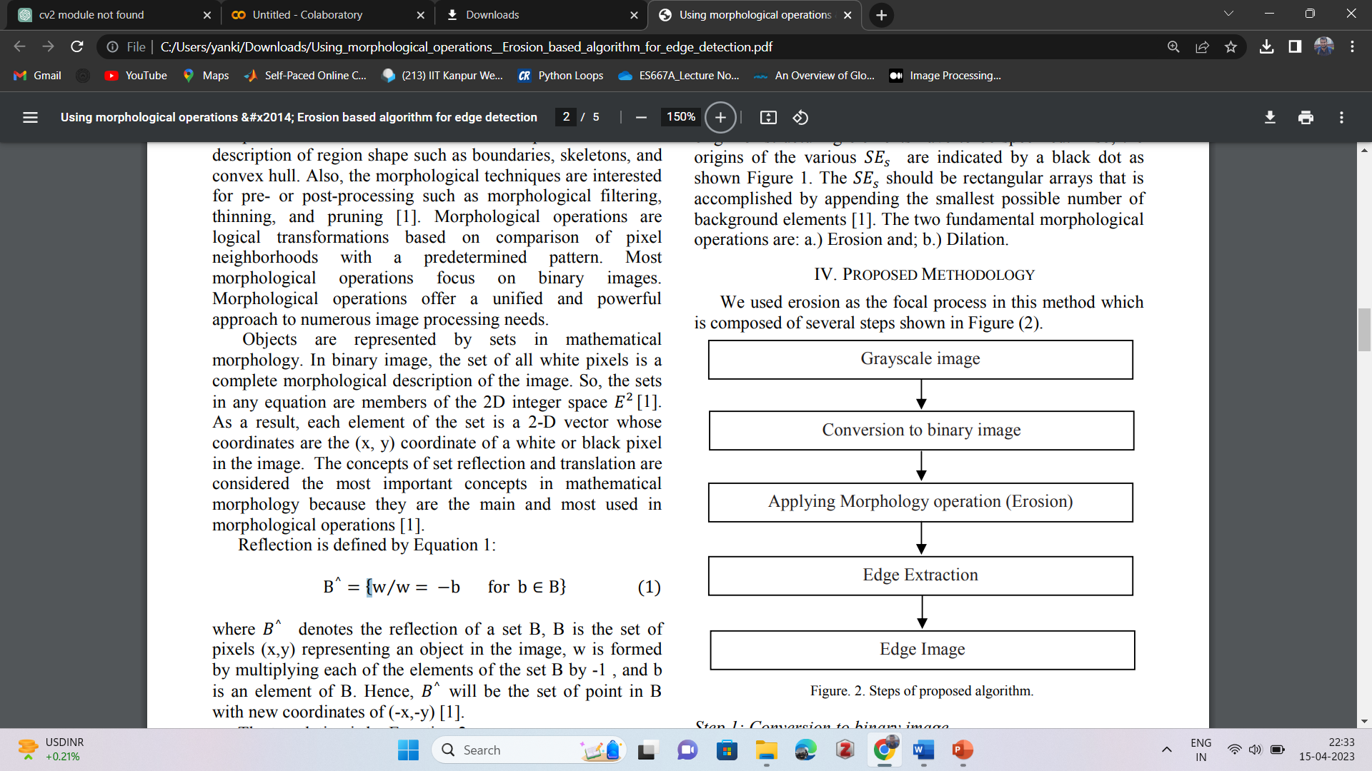
PROPOSED METHODOLOGY :
Source : Using morphological operations &#x2014; Erosion based algorithm for edge detection.

Slide 9
Various Steps:
Load the input image as a binary image using cv2.imread('input_image.tif', cv2.IMREAD_GRAYSCALE).
Perform automatic thresholding using Otsu's method by calling cv2.threshold() with the input image and the cv2.THRESH_BINARY | cv2.THRESH_OTSU flags. This step converts the input image into a binary image, where the objects of interest are white and the background is black.
Define a 3x3 square structuring element using cv2.getStructuringElement(cv2.MORPH_RECT, (3, 3)). The structuring element defines the shape and size of the morphological operation, such as dilation or erosion.
Perform dilation and erosion operations on the binary image using the structuring element by calling cv2.dilate() and cv2.erode(). These operations expand or shrink the object boundaries, respectively. The iterations parameter specifies how many times to repeat the operation.

Slide 10
Take the difference between the dilated and eroded images to obtain the gradient image using cv2.absdiff(). The gradient image highlights the edges of the objects in the input image.
Perform thresholding on the gradient image to obtain the edges using cv2.threshold(). The cv2.THRESH_BINARY | cv2.THRESH_OTSU flags are used again to perform automatic thresholding using Otsu's method. This step converts the gradient image into a binary image, where the edges are white and the background is black.
Display the input image, binary image, and resulting edges using cv2.imshow(). The cv2.waitKey(0) call waits for a key event, and the cv2.destroyAllWindows() call closes all windows.

Slide 11
Code:
from google.colab.patches import cv2_imshow
import numpy as np
import cv2
# Load the input image as a binary image
input_img = cv2.imread('4-Figure5-1.png', cv2.IMREAD_GRAYSCALE)
# Perform automatic thresholding using Otsu's method
_, binary_img = cv2.threshold(input_img, 0, 255, cv2.THRESH_BINARY | cv2.THRESH_OTSU)
# Define a 2x2 square structuring element
structuring_element = cv2.getStructuringElement(cv2.MORPH_RECT, (3, 3))
# Perform dilation and erosion operations on the input image using the structuring element
dilated_img = cv2.dilate(binary_img, structuring_element, iterations=1)
eroded_img = cv2.erode(binary_img, structuring_element, iterations=1)
# Take the difference between the dilated and eroded images to obtain the gradient image
gradient_img = cv2.absdiff(dilated_img, eroded_img)
# Perform thresholding on the gradient image to obtain the edges
_, edges = cv2.threshold(gradient_img, 0, 255, cv2.THRESH_BINARY | cv2.THRESH_OTSU)
# Display the input image
cv2_imshow(input_img)
# Display the binary image
cv2_imshow(binary_img)
# Display the resulting edges
cv2_imshow(edges)
cv2.waitKey(0)
cv2.destroyAllWindows()

Slide 12
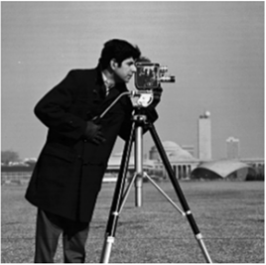


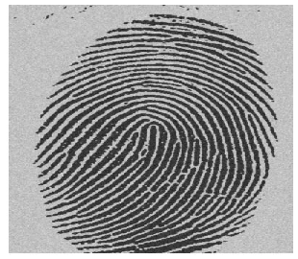
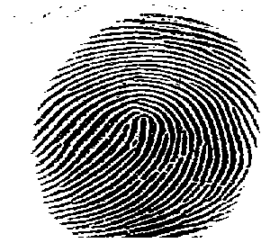
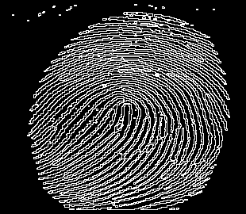
Results :
Input image
Binary Image
Edges
Source : Using morphological operations &#x2014; Erosion based algorithm for edge detection

Slide 13
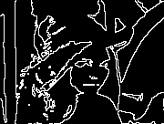




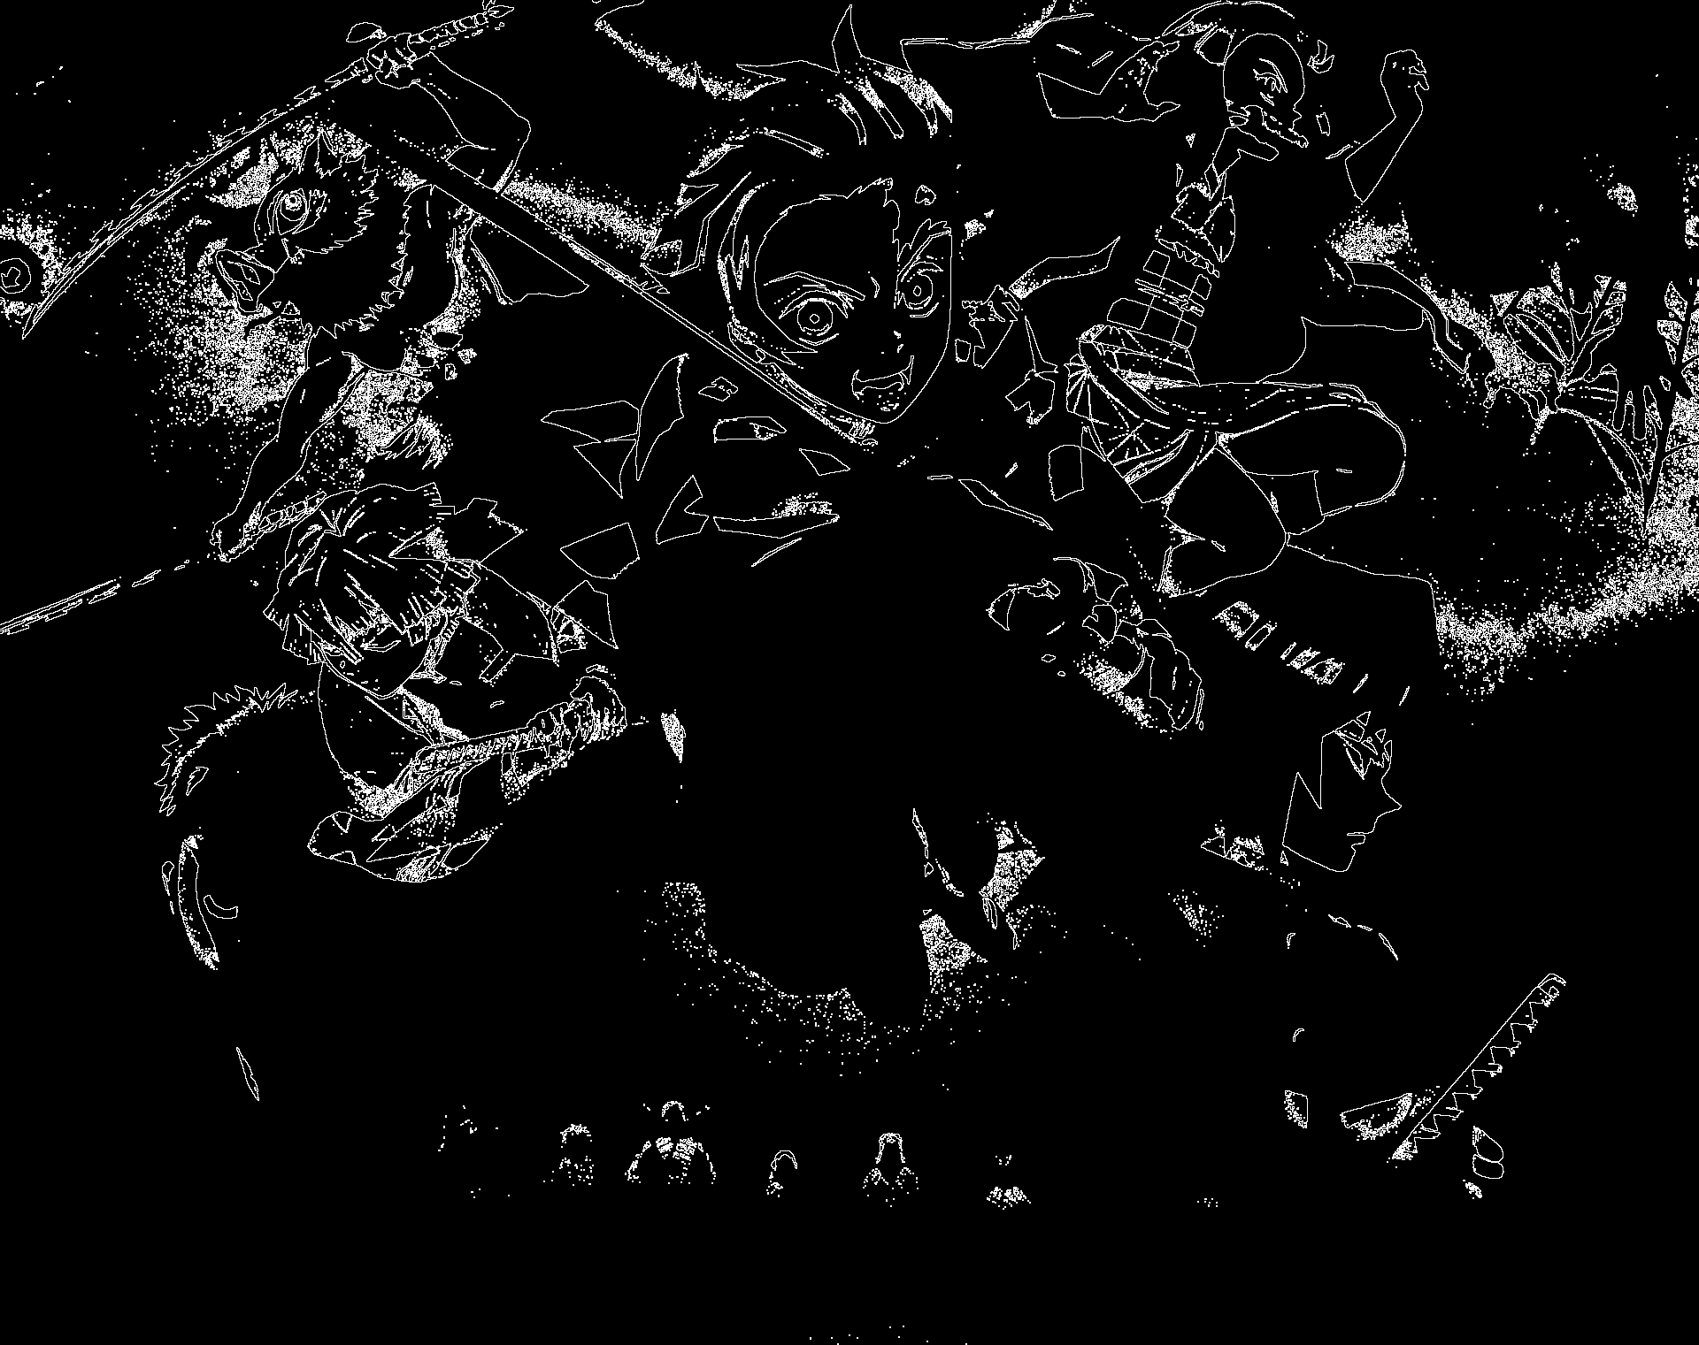
Input image
Binary Image
Edges
Source : Using morphological operations &#x2014; Erosion based algorithm for edge detection

Slide 14
CONCLUSION:
This method provides us with better results in Edge extraction.
This method provides us with clear, thin, and continuous edges.
The results obtained from this method are better than classical edge detection methods.
This Methods require less time processing time so, it is time efficient.
This method is used when there are some more complex edges and contrast base challenges.

Slide 15
REFERENCES :
Gonzalez, C. R., & Woods, R. E. (2008). Digital Image Processing. Pearson Education International
Rashmi, Mukesh Kumar, Rohini Saxena, “Algorithm and Technique on Various Edge Detection: a survey,” Signal & Image Processing: An International Journal (SIPIJ) Vol.4, No.3, pages 65-75, June 2013.
C. Sujathaand and Dr. D. Selvathi, “An optimal solution for image edge detection problem using simplified Gabor wavelet,” International Journal of Computer Science, Engineering and Information Technology (IJCSEIT), vol. 2, No.3, June 2012.
Abhradita Deepak Borkar, Mithilesh Atulkar, “Detection of edges using fuzzy inference system,” International Journal of Innovative Research in Computer and Communication Engineering (2320 – 9798). Volume 1, issue1 March 2013.
Sheng Zheng, Jian Liu, and Jin Wen Tian, “A new efficient SVM-based edge detection method,” Pattern Recognition Letters, Volume 25 Issue 10, Pages 1143 - 1154, 16 July 2004.

Slide 16

Thank you Any Questions?

